Slide 1

Analog and Digital Integrated Circuits EE- ECE2011A

Slide 2
Unit III Non-Linear Applications

Slide 3
Lesson Plan
Topic | Sub points | Book-Page Nos.
Voltage Comparator | Inverting,Non inverting ,Characteristics,Voltage Limiters | T1-315
Schmitt Trigger-Inverting | Working,transfer curve | T1-317 , R1-218
Schmitt Trigger-Non-Inverting | Just explaination | R1-317
Voltage Limiters | Working | T1-351
Precision Rectifier,Half wave | Saturating and non saturating working ,waveforms, | T1-240, R1-163
Precision Full wave Rectifiers | Working ,waveforms | R1-167
Square Wave Generator,Triangular Wave | Working | T1-287
Notes:
T1: Fourth Edition, Ramakant Gayakwad, “Op-Amps and Linear Integrated Circuits”

Slide 4
Non Linear Applications
High gain Amplifier with positive feedback or without feedback- it operates in ±Vsat
This is called as bistable behavior of Op-Amp and it is highly non linear.

Slide 5
Important Concepts
Comparator
With help of Diode
Schmitt Triggers
Precision Rectifiers
Waveform Generators
Clippers / Clampers
Peak Detector / Sample and Hold

Slide 6
What is a Comparator??
Its input is analog and its output is digital (1/0 or high/low).
It is a one-bit Analog-to-Digital Converter (ADC) .
The output changes its state when the input voltage crosses a reference value.

Slide 7
Types of Comparators
Inverting Type
+ve reference or –ve reference
Non-Inverting Type
+ve reference or –ve reference
Zero Crossing Detector
Zero Reference. Switching will happen when input crosses zero level.

Slide 8
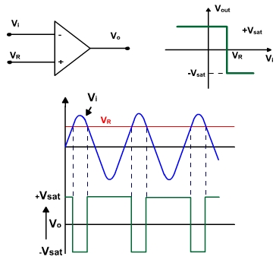
Comparator
An analog comparator has two inputs one is usually a constant reference voltage VR and other is a time varying signal vi and one output VO.
Figure 1

Slide 9
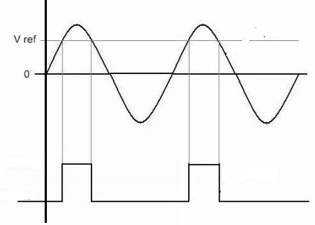
Comparator Waveforms
Vin
Vp < Vn
Vp > Vn
Vp < Vn
Vo
Vo = +Vsat
Vo = +Vsat
Vo = - Vsat
Vo = - Vsat

Slide 10
Working
When the noninverting voltage is larger than the inverting voltage the comparator produces a high output voltage (+V_{sat}). When the non-inverting output is less than the inverting input the output is low (-V_{sat}).
Fig 1, also shows the output of a comparator for a sinusoidal input is
Vo = -Vsat if vi > Vr
Vo = + V_{sat} if v i < V_{R}

Slide 11
Non-Inverting Type
+Reference
-reference
Waveforms
Transfer characteristics
Diodes D1 and D2 protect the Op-Amp from damage due to excessive input voltage Vin- Clamp diodes
R in series with vin is used to limit the current through the diodes
Rom ≈ R is connected to inverting terminal to reduce the offset

Slide 12
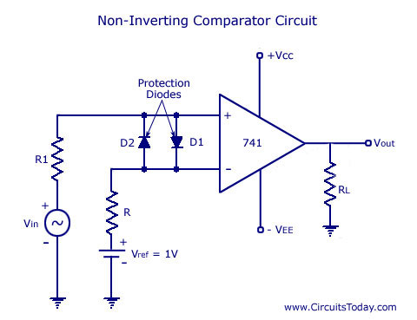
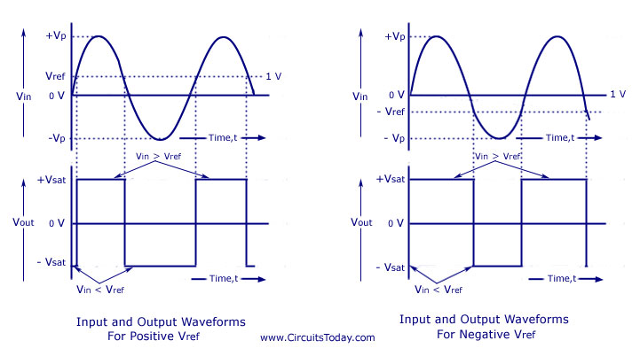

Slide 13
Inverting Type
+Reference
-reference
Waveforms
Transfer characteristics

Slide 14
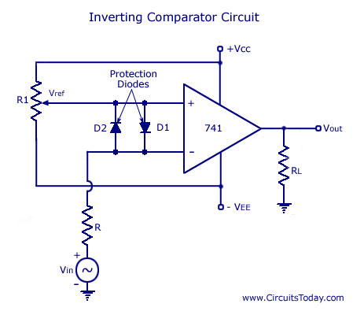
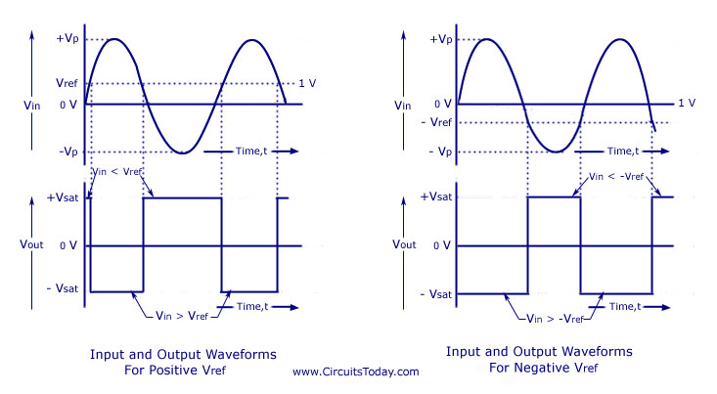

Slide 15
Zero Crossing Detector
Reference voltage is zero
Waveforms

Slide 16
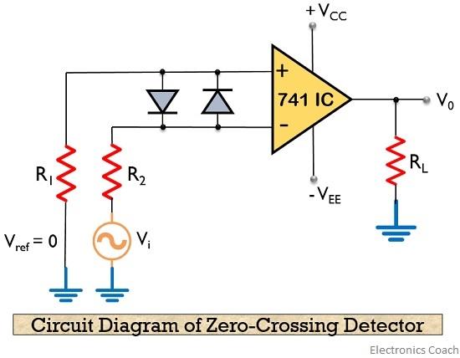
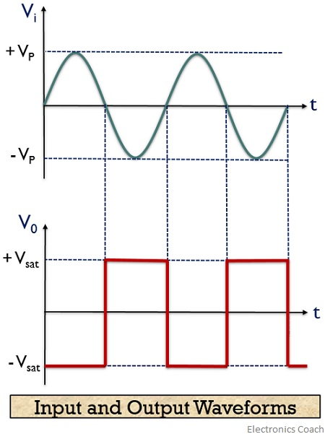

Slide 17
Comparator Characteristics
Speed of Operation: switching speed, high slew rate is required
Accuracy: it depends on voltage gain, CMRR, input offset, thermal drift
Compatibility of output with any digital family
**Compensated Op-Amp (IC 741): Internal capacitor for stabilization, capacitor slows down rate of change of output
Un compensated Op-Amp(IC 301): Don’t have internal capacitor , so output rises at a much faster speed as compared with compensated Op-amp
Comparator Ics: LM 339, LM 311

Slide 18
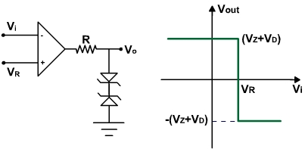
Voltage Limiters
If we want to limit the output voltage of the comparator two voltages (one positive and other negative)then a resistor R and two zener diodes are added to clamp the output of the comparator. The circuit of such comparator is shown in Fig, The transfer characteristics of the circuit is also shown below

Slide 19
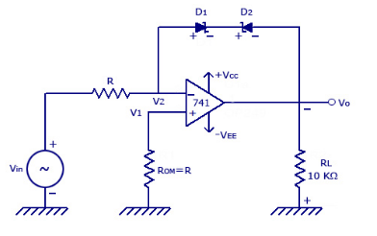
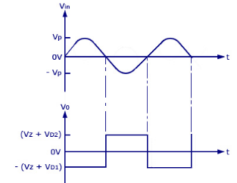
Voltage Limiters with zener diodes
Notes:
http://www.circuitstoday.com/voltage-limiter-circuit-using-op-amp

Slide 20
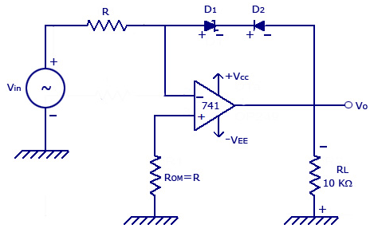
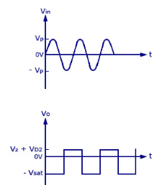
The figure below shows a combination of zener diode and rectifier diodes: Positive output voltage Limiting

Slide 21
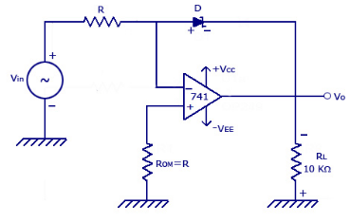
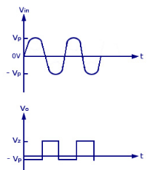
Voltage Limiter with single zener diode

Slide 22
Comparator Applications
Level detectors / Window Detectors
Automatic Measurement of physical signals and control – Biomedical, Agriculture, Industrial Process Plants etc.
Musical Instruments
Zero –Crossing Detectors
frequency / phase measurement.
One bit ADC / PWM generator / Signal generators
Communication Systems
Switching Regulators
Power Supplies

Slide 23
Comparator ICs
LM311 / LM339.
Open collector output:- Pull up resistor is necessary.
Can work on Single Power Supply.

Slide 24
**741- compensated- internal C- it slows down the rate of change of output
Slew rate is 0.5V/microsec
**301-uncompensated- no C- output rises much faster
Slew rate is higher than compensated op amp
Uncompensated Ics are used as comparator

Slide 25
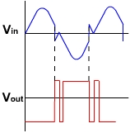
Noise in Zero Crossing Detector
If Noise exists near ground level it can create false triggering and cause chattering of relay.
So give positive feedback to comparator and improve noise immunity. Such a regenerative comparator is called Schmitt Trigger.

Slide 26
Noise Immunity
Inherent but very small ‘hysteresis!’
False triggering due to noise!
Use offset minimizing techniques.
Select op-amp with very small offset voltage.
Use Positive feedback.
Notes:
The noise immunity is very less for open loop configurations.
For the full output transition to occur, the input voltage must pass the threshold voltage by an amount = delta Vi = delta Vo/open loop gain. As open loop gain is very high, delta Vi comes out in mV or micorvolt. If the change in the input is less than this value, the output will not switch. This is called inherent hysteresis!
Every comparator has some inbuilt hysteresis of typically 150 microvolt. If the change in input voltage is less than 150 uV, then output will not change its state. But, in real situations, the noise is inherent in the input signal. So, input signal may be distorted . This distortion is usually greater than 150 uV. That means, we will get false transitions. So it is necessary to increase this hysteresis width. This can be accomplished by positive feedback.

Slide 27
Schmitt Trigger
If the input to a comparator contains noise, the output may be erractive when v_{in} is near a trip point.
For instance, with a zero crossing, the output is low when v_{in} is positive and high when v_{in} is negative.
If the input contains a noise voltage with a peak of 1mV or more, then the comparator will detect the zero crossing produced by the noise.
Figure 2 shows the output of zero crossing detection if the input contains noise.

Slide 28
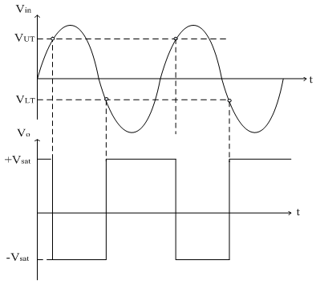
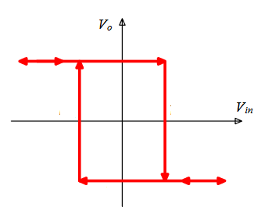
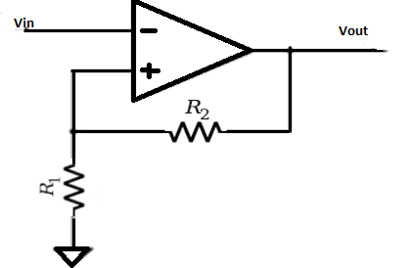
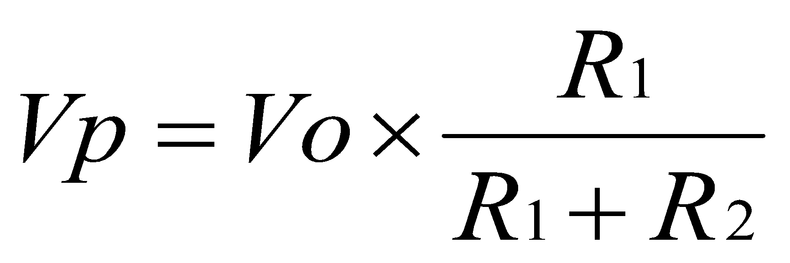
Schmitt Triggers
V_{OH}
V_{LT}
V_{UT}
V_{OL}
Figure 3
circuit is insensitive to the changes in the i/p in this region
Hysteresis Width
Figure 2
Notes:
The amount of hysteresis or dead band added is directly proportional to the amount of positive feedback (beta). VH = 2Vsat*beta

Slide 29
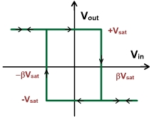
Hysteresis Loop (Transfer Characteristics)
Figure 4

Slide 30
Noise Immunity
Inherent but very small ‘hysteresis!’
False triggering due to noise!
Use offset minimizing techniques.
Select op-amp with very small offset voltage.
Use Positive feedback.
Notes:
The noise immunity is very less for open loop configurations.
For the full output transition to occur, the input voltage must pass the threshold voltage by an amount = delta Vi = delta Vo/open loop gain. As open loop gain is very high, delta Vi comes out in mV or micorvolt. If the change in the input is less than this value, the output will not switch. This is called inherent hysteresis!
Every comparator has some inbuilt hysteresis of typically 150 microvolt. If the change in input voltage is less than 150 uV, then output will not change its state. But, in real situations, the noise is inherent in the input signal. So, input signal may be distorted . This distortion is usually greater than 150 uV. That means, we will get false transitions. So it is necessary to increase this hysteresis width. This can be accomplished by positive feedback.

Slide 31
How to decide threshold voltages?
V_{lt} and V_{ut} should be greater than Noise Voltages.
R₁ and R₂ can be selected according to the values of V_{lt} and V_{ut} .

Slide 32
Schmitt Trigger - Types
Inverting and Non-inverting
Symmetric (| V_{lt} | = | V_{ut} | )
Asymmetric (| V_{lt} | ≠ | V_{ut} | )

Slide 33
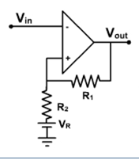
Asymmetric ST Using additional Vdc
Applying KVL
Vo=IR1+IR2+VR
∴I=(Vo-VR)/((R1+R2 ) )
The threshold point
VT =IR2+VR
VT =[(Vo-VR)/(R1+R2 )] R2+VR …..(1)
VT =R2/(R1+R2 ) Vo-R2/(R1+R2 ) VR+VR
VT =R2/(R1+R2 ) Vo+R1/(R1+R2 ) VR
When Vout=+Vsat , VT =+ve
When Vout=-Vsat , VT = -ve

Slide 34
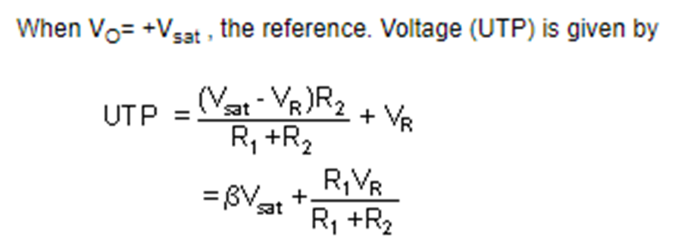
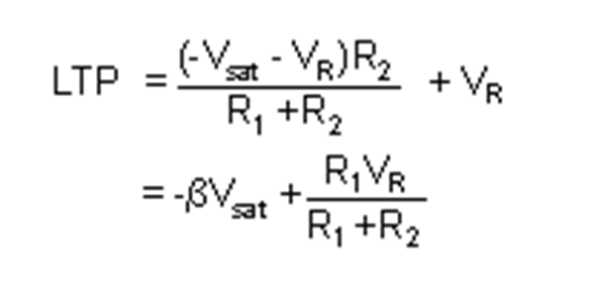
Using Eq 1,

Slide 35

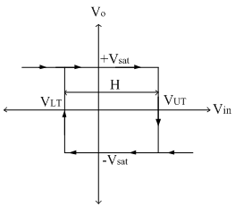
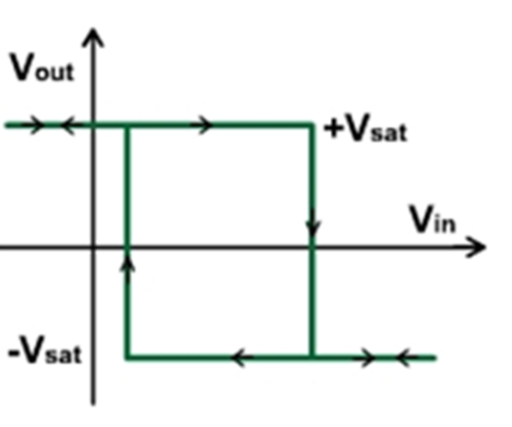

Slide 36
If VR is positive the loop is shifted to right side; if VR is negative, the loop is shifted to left side. The hysteresis voltage Vhys remains the same.

Slide 37
Asymmetric inverting ST using diode

Slide 38
Non Inverting Schmitt Trigger

Slide 39
Design Schmitt Trigger
Given:
V_{lt} , V_{ut}
V_{supply}
R1.
Find:
R2
V_{DC}
To Draw:
Hysteresis
Waveforms
Two Ways to design Asymmetric Schmitt Trigger:
Using additional VDC
Using diodes & Resistors in series in feedback path.

Slide 40
Example 1
If V_{sat} = 13.5 V, what are the trip points and hysteresis in Figure below?
+15V
V_{in}
V_{out}
-15V
47 kΩ
1 kΩ

Slide 42
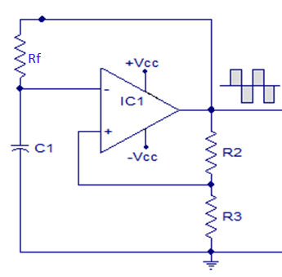
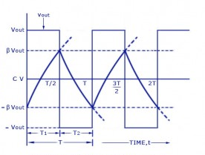
Waveform Generators
Astable Multivibrator
C not allowed to charge more as Vout trips to –ve level.
Duty Cycle variation by using diodes in series with Rf in feedback path.

Slide 43
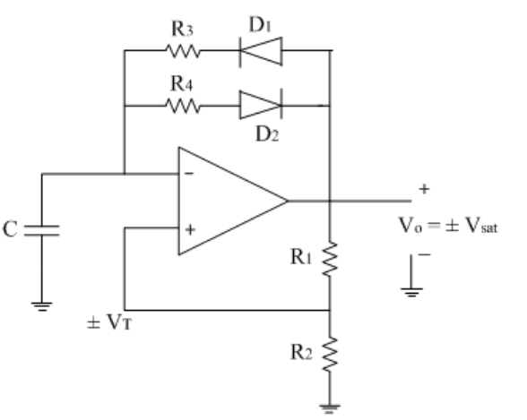
Asymmetrical Square wave generator
https://www.electronics-tutorial.net/analog-integrated-circuits/multivibrators/asymmetrical-square-wave-generator/

Slide 44
When output is high (i.e. +Vsat), diode D1 is forward biased and capacitor C starts charging through resistance R3towards +Vsat and diode D2 is reversed biased. Therefore the charging time constant of the capacitor is τc=R3 C When output is low (i.e. -Vsat), diode D2 is forward biased and capacitor C starts charging through resistance R3 towards –Vsat (i.e. discharging in negative direction) and diode D1 is reversed biased. Therefore the discharging time constant of the capacitor is τd=R4 C
As in both the cases time constant is different, we get different ON and OFF time for output square wave and hence asymmetrical square wave.

Slide 45
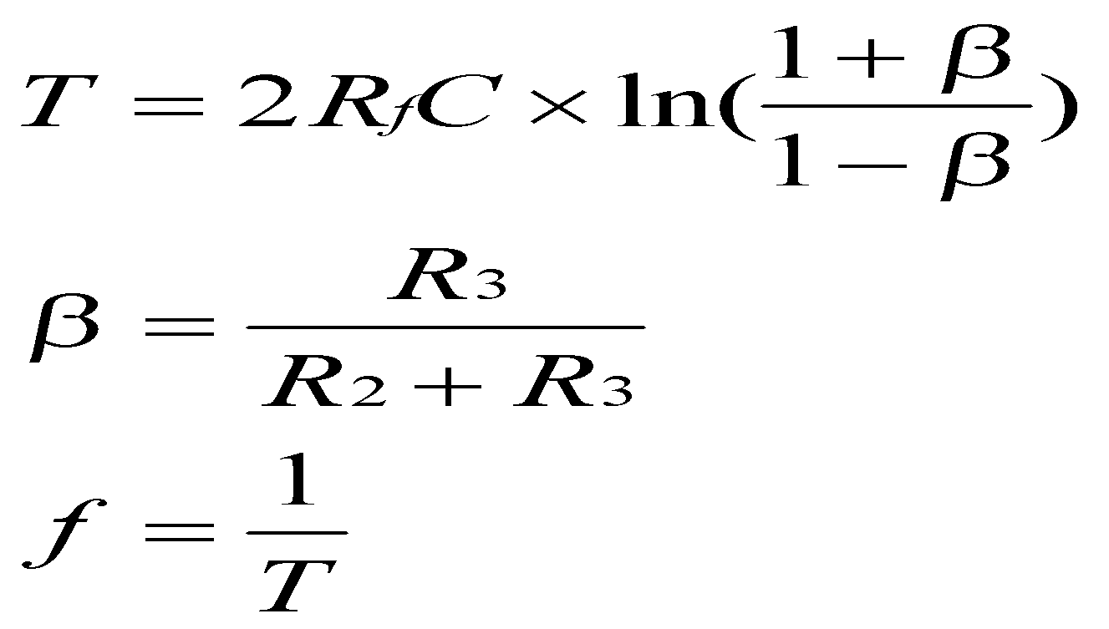
Important Equations

Slide 46
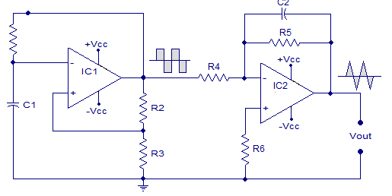

Triangular Wave Generator-1
Input voltage of IC2 is closer to Vsat levels. To avoid this use zener diodes.
Design this Integrator with fb = fout.
5*R4*C2 >> T/2, T of square waveform
For stable output, R5 = 10R4, R6=Rom
Notes:
The amplitude of the triangular wave decreases with an increase in its frequency and vice a versa.

Slide 47
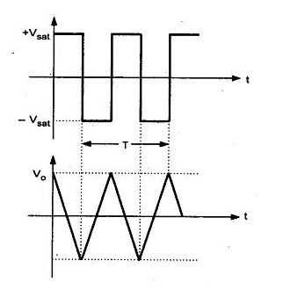
Although the amplitude of the square wave is constant (± Vsat), the amplitude of the triangular wave decreases with an increase in its frequency, and vice versa. This is because the reactance of capacitor decreases at high frequencies and increases at low frequencies.

Slide 48
Design Waveform Generator
Given:
V_{opp,} fo, Duty Cycle, β, C
Find:
R3, R2, Rf and components related to integrator circuit.
To draw:
Waveforms across timing capacitor, output of IC1 and IC2.

Slide 49
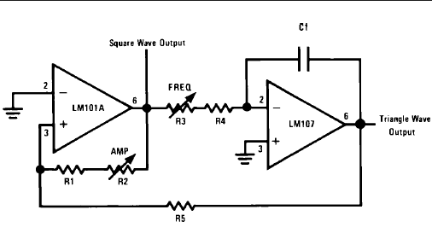
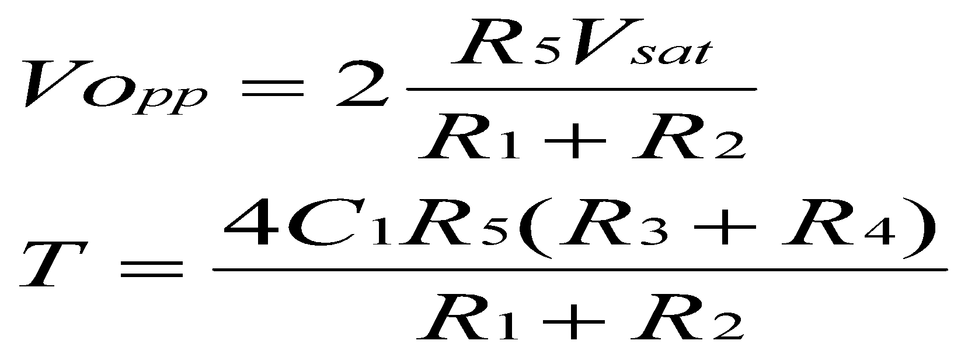
Triangular Wave Generator-2 using Comparator and Integrator with fewer components

Slide 50
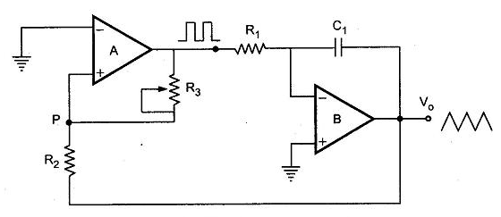
Triangular Wave Generator-2
It consists of a comparator (A) and an integrator (B). The output of comparator A is a square wave of amplitude ± Vsat and is applied to the inverting (—) input terminal of the integrator B. The output of integrator is a triangular wave and it is feedback as input to the comparator A through a voltage divider R2 R3.
Notes:
http://www.eeeguide.com/triangular-wave-generator-using-op-amp/

Slide 51
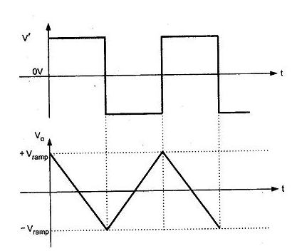
Waveforms of triangular waveform generator
Assume that the output of comparator A is at + Vsat . This forces a constant current through C to give a negative going ramp at the output of the integrator, as shown in the Fig. Therefore, one end of voltage divider is at a voltage +Vsat and the other at the negative going ramp.
When the negative going ramp reaches a certain value — Vramp, the effective voltage at point
As a result, the output of comparator A switches from positive saturation to negative saturation (— Vsat). This forces a reverse constant current (right to left) through C to give a positive going ramp at the output of the integrator, as shown in the Fig. 2.89. When positive going ramp reaches + Vramp, the effective voltage at point p becomes slightly above OV. As a result, the output of comparator A switches from negative saturation to positive saturation (+Vsat ). The sequence then repeats to give triangular wave at the output of integrator B.

Slide 52

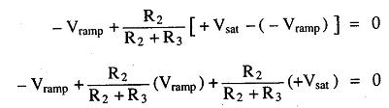
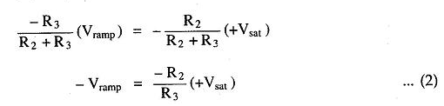
When comparator output is at +Vsat , the effective voltage at point P is given by
When effective voltage at P becomes equal to zero, we can write above equation

Slide 53



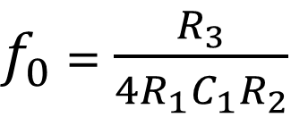
Similarly, when comparator output is at – Vsat, we can write,
The peak to peak amplitude of the triangular wave can be given as
$f_{0}$ = $\frac{R_{3}}{4R_{1}C_{1}R_{2}}$

Slide 54
Precision Rectifier
Ordinary diodes cannot rectify voltages below cut-in voltage of the diode.
A circuit which act as an ideal diode or precision signal processing rectifier for rectifying voltages which are below the level of cut-in voltage can be designed by placing the diode in the feedback loop of an opamp

Slide 55
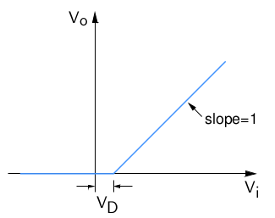
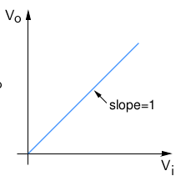
Precision Rectifier
Simple Diode Rectifier:
Expected
Not useful for small signal applications!

Slide 56
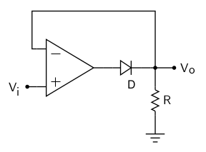
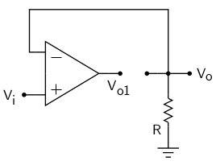
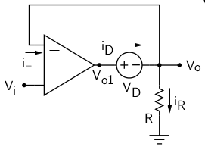
Basic Half Wave Precision Rectifier
Limitation on Switching Speed !
(I) Vi < 0V
(III) Vi > 0V
(II)
Vi very small but Positive: D still OFF, Vo1 goes to +Vsat, Immediately D turns ON.
=0
=Vi
-Vsat
Vi + 0.7

Slide 57
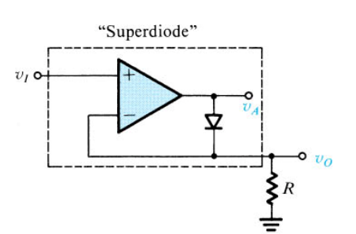
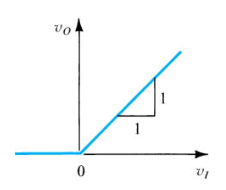

Slide 58
Limitations
The circuit has some serious limitations.
The main one is speed. It will not work well with high frequency signals.
• For a low frequency positive input signal, 100% negative feedback is applied when the diode conducts. The forward voltage is effectively removed by the feedback, and the inverting input follows the positive half of the input signal almost perfectly.
• When the input signal becomes negative, the op amp has no
feedback at all, so the output pin of the op amp swings negative as far as it can.
• When the input signal becomes positive again, the op amp's output voltage will take a finite time to swing back to zero, then to forward bias the diode and produce an output. This time is determined by the op amp's slew rate, and even a very fast op amp will be limited to low frequencies.

Slide 59
Advantages
No diode voltage drop between input and output
The ability to rectify very small voltages
Amplification if required
Low output impedance
**While the input waveform is in its negative half cycle, the output of the Op-Amp is saturated in a negative direction. Some time is required to get the Op-Amp out of saturation and this will limit the frequency response of the circuit.
So for high frequency performance, a nonsaturating precision rectifier circuit must be used

Slide 60
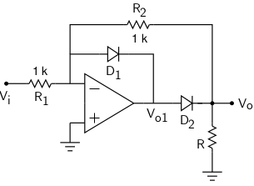
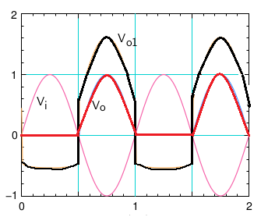
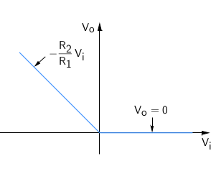
Improved Half Wave Precision Rectifier
Op-amp doesn’t enter into saturation! Switching speed Improves.

Slide 62
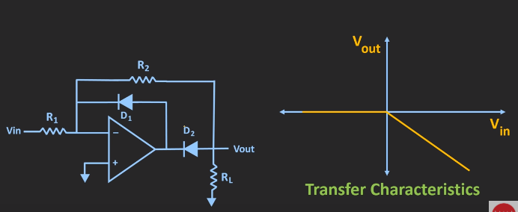
HWR

Slide 63


Precision FWR

Slide 64






Full Wave Precision Rectifier

Slide 65

Full Wave Precision Rectifier
The Precision Full Wave Rectifiers circuits accept an ac signal at the input, inverts either the negative or the positive half, and delivers both the inverted and non inverted halves at the output, as shown in the Fig.

Slide 66

Precision Full Wave Rectifier

Slide 67

Working
CASE 1 : V_{i} > 0 : When Vi > 0, inverting side of A_{l} will force its output to swing negative, thus forward biasing D₁ and reverse biasing D2. Since no current flows through resistance R connected between V_{n1} and V_{p2}, both are equipotential

Slide 68

Working
CASE 2 : V_{i} < 0 : When Vi < 0, negative, the output voltage of A_{l} swings to positive, making diode D1 reverse biased and diode D2 forward biased.

Slide 69

Working
To find Vo in terms of V we concentrate on the equivalent circuit of A2, as shown

Slide 70

Full Wave Rectifier Waveforms

Slide 71
Criteria for Selecting Components
High Slew Rate Op-amps (LF351)
High GBWP ( > 10 * Gain * f_{input})
Fast switching diodes (1N4148)
Low values of R (typically 1kΩ)
Notes:
LF351: SR = 13 V / us and GBWP =4MHz.

Slide 72
Precision Rectifiers-Applications
Small Signal – High Frequency Applications.
Waveshaping Circuits
AC-DC converters.

Slide 73
Extra Slides 72 to 90

Slide 74



Peak Detectors
A peak detector is simply a circuit that traces the peaks in an input signal.
Leakage current must be less !
× Electrolytic , Tantalum
Polypropylene or Polysterene
For proper operation of the circuit, the charging time constant CRd and
discharging time constant must satisfy above equation.
Notes:
AC voltmeter can measure the rms value of pure sine wave only. Hence for non-sinusoidal waveforms, we can use peak detector to measure peak values.

Slide 75
For proper operation of the circuit, the charging
time constant (CR_{d} ) and discharging time constant
(CR_{L}) must satisfy the following condition.
CR_{d} <= T/10
Where R_{d} = Resistance of the forward-biased diode.
T = time period of the input waveform.
CRL >= 10T (2)
Where R_{L} = load resistor.
If R_{L} is very small so that eqn. (2) cannot be satisfied.

Slide 76

R is used to protect op-amp against the excessive discharge currents when the power supply is switched off.
Rcomp minimizes the offset problems. D2 conducts during negative half cycle and hence prevents the op-amp from going into negative saturation

Slide 77


Waveshaping Circuits
Waveshaping circuits are commonly used in digital computers and communications such as TV and FM receivers.
It includes Clippers and Clampers
Circuit Protection by Amplitude Limitation.
Removing distortions by level shifting.

Slide 78
Wave shaping circuits are the electronic circuits, which produce the desired shape at the output from the applied input wave form. These circuits perform two functions −
Attenuate the applied wave
Alter the dc level of the applied wave.
There are two types of wave shaping circuits: Clippers and Clampers.

Slide 79
The main advantage of clippers is that they eliminate the unwanted noise present in the amplitude of an ac signal.
Clippers can be classified into the following two types based on the clipping portion of the input.
Positive Clipper
Negative Clipper

Slide 80



Positive Clippers(Removes +ve peaks)

Slide 81

Negative Clipper
Draw the waveforms

Slide 82

Clampers
It adds a desired DC level to
the ac input signal
Positive Clamper
Negative Clamper
Peak Clamper

Slide 83


Assuming Vin = 0, Op Amp output is positive, diode D is forward biased, Circuit works as voltage follower,
${Vo}^{′}$ = $V_{ref}$, C1 is open circuit for DC voltage

Slide 84

Assuming $V_{ref}$ = 0, When Vin is negative, output is positive, D is forward biased, C charges towards Vm through the Diode.

Slide 85

When Vin is positive op amp output is negative, D is reverse
biased, there is no discharge path for C, ${Vo′}^{′}$ = $V_{m}+Vin$

Slide 86



Vo = ${Vo}^{′}+{Vo}^{′′}$ = $V_{ref}+V_{m}+Vin$

Slide 87

Sample and Hold
As the name indicates , a sample and hold circuit is a circuit which samples an input signal and holds onto its last sampled value until the input is sampled again.
Sample and hold circuits are commonly used in analogue to digital converts, communication circuits, PWM circuits etc.

Slide 88

When the switch is locked sampling method will come into the image and when the switch is unlocked holding outcome will be there. The capacitor allied to the second op-amp is nothing but a holding capacitor.

Slide 89

As a switching element, the N-channel Enhancement MOSFET is used. The input voltage is given via its drain terminal and control voltage is also given through its gate terminal. When the +ve pulse of the control voltage is applied, the MOSFET will be activated state. And it performs as a closed switch. On the opposing, when the control voltage is nothing then the MOSFET will be deactivated state and works as the open switch.

Slide 90


Slide 91
When the MOSFET works as a closed switch, the analog signal given to it through the drain terminal will be fed to the capacitor. Then the capacitor will charge to its peak value. When the switch is released, then the capacitor discontinues charging. Due to the high impedance op-amp connected at the circuit end, the capacitor will knowledge high impedance due to this it cannot get discharged
This directs to the holding of the charge by the capacitor for the exact amount of time. This can be referred as holding period. And the time in which samples of i/p voltage is produced is named sampling period. The o/p processed by op-amp throughout the holding period. So, holding period holds implication for Op-Amps.
Low leakage capacitors: Teflon, polyethylene

Slide 92
Sample & Hold Circuit

Slide 93
References
Ramakant Gayakwad, “Op-amps and Linear Circuits”, Pearson Education, 2000.
Salivahanan and Kanchana Bhaskaran, “Linear Integrated Circuits”, Tata McGraw Hill.
George Clayton and Steve Winder, “Opeartional Amplifiers”, 5Th Edition, Newness.
Sergio Franco, “Design with Operational Amplifiers and Analog Integrated Circuits”, Tata McGraw Hill.
William Stanley, “Operational Amplifiers with Linear Integrated Circuits,” 4Th Edition, Pearson Education.
http://nptel.ac.in/courses/117107094
https://www.youtube.com/watch?v=NVj_Eu3sJL4 (Lecture Series by Prof. T. S. Natarajan, Dept. of Physics, IIT Madras).

Slide 94
References:
https://nptel.ac.in/courses/117107094/lecturers/lecture_17/lecture17_page3.htm
https://nptel.ac.in/courses/117107094/lecturers/lecture_18/lecture18_page2.htm

